Slide 1
Logical Agents
Chapter 7

Slide 2
Outline
Knowledge-based agents
Wumpus world
Logic in general - models and entailment
Propositional (Boolean) logic
Equivalence, validity, satisfiability
Inference rules and theorem proving
  forward chaining
  backward chaining
  resolution

Slide 3
Knowledge Bases
Inference Engine
Knowledge Base
Domain-independent Algorithm
Domain-Specific Content
Knowledge base = set of sentences in a formal language
Declarative approach to building an agent (or other system):
  Tell it what it needs to know
Then it can Ask itself what to do - answers should follow from the KB
Agents can be viewed at the knowledge level
  i.e., what they know, regardless of how implemented
Or at the implementation level
  i.e., data structures in KB and algorithms that manipulate them

Slide 4
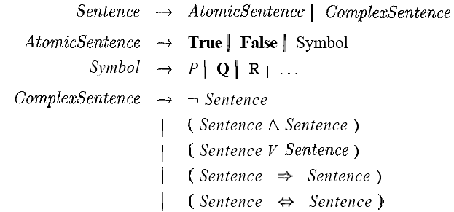
Propositional Logic:
A Very Simple Logic

Slide 5

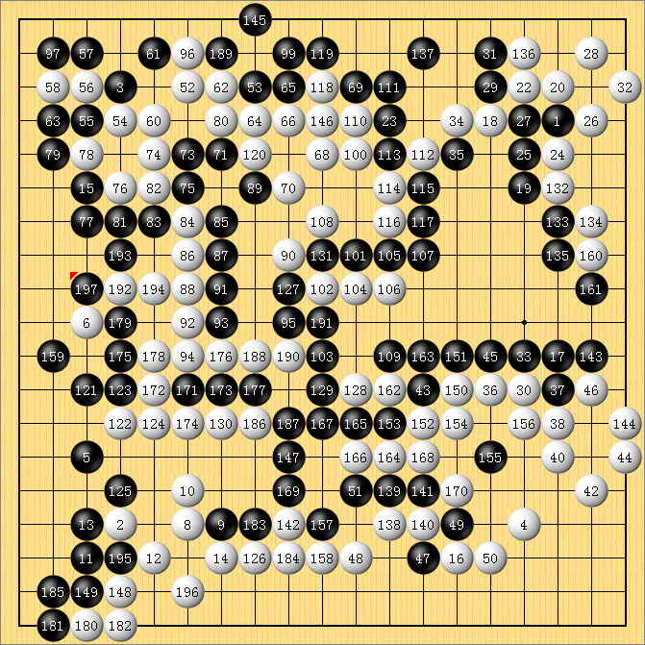
A simple knowledge-based agent
The agent must be able to:
  Represent states, actions, etc.
  Incorporate new percepts
  Update internal representations of the world
  Deduce hidden properties of the world
  Deduce appropriate actions

Slide 6

Wumpus World PEAS description
Performance measure
  gold +1000, death -1000
  -1 per step, -10 for using the arrow
Environment
  Squares adjacent to wumpus are smelly
Sensors: Stench, Breeze, Glitter, Bump, Scream
Actuators: Left turn, Right turn, Forward, Grab, Release, Shoot
  Squares adjacent to pit are breezy
  Glitter iff gold is in the same square
  Shooting kills wumpus if you are facing it
  Shooting uses up the only arrow
  Grabbing picks up gold if in same square
  Releasing drops the gold in same square

Slide 7
Wumpus World PEAS description
A =Agent
B = Breeze
G = Glitter, Gold
OK = safe square
P = Pit
S = Stench
V = Visited
W =Wumpus

Slide 8
Wumpus world characterization
Fully Observable No – only local perception
Single-agent? Yes – Wumpus is essentially a natural feature
Deterministic Yes – outcomes exactly specified
Episodic No – sequential at the level of actions
Static Yes – Wumpus and Pits do not move
Discrete Yes

Slide 9

Exploring a wumpus world

Slide 10

Exploring a wumpus world

Slide 11

Exploring a wumpus world

Slide 12

Exploring a Wumpus World

Slide 13

Exploring a wumpus world

Slide 14

Exploring a wumpus world

Slide 15

Exploring a wumpus world

Slide 16

Exploring a wumpus world

Slide 17
Logic in general
Logics are formal languages for representing information such that conclusions can be drawn
  i.e., define truth of a sentence in a world
E.g., the language of arithmetic
  x+2 ≥ y is a sentence; x2+y > {} is not a sentence
  x+2 ≥ y is true iff the number x+2 is no less than the number y
  x+2 ≥ y is true in a world where x = 7, y = 1
  x+2 ≥ y is false in a world where x = 0, y = 6
Syntax defines the sentences in the language
Semantics define the "meaning" of sentences;

Slide 18
Entailment
Entailment means that one thing follows from another:
KB ╞ α
Knowledge base KB entails sentence α if and only if α is true in all worlds where KB is true
  E.g., the KB containing “the Giants won” and “the Reds won” entails “Either the Giants won or the Reds won”
  E.g., x+y = 4 entails 4 = x+y
  Entailment is a relationship between sentences (i.e., syntax) that is based on semantics

Slide 19

Models
Logicians typically think in terms of models, which are formally structured worlds with respect to which truth can be evaluated
We say m is a model of a sentence α if α is true in m
M(α) is the set of all models of α
Then KB ╞ α iff M(KB) ⊆ M(α)
  E.g. KB = Giants won and Reds
  won; α = Giants won

Slide 20

Entailment in the wumpus world
Situation after detecting nothing in [1,1], moving right, breeze in [2,1]
Consider possible models for KB assuming only pits
Boolean choices ⇒ 8 possible models

Slide 21

Wumpus models

Slide 22

Wumpus models
KB = wumpus-world rules + observations

Slide 23

Wumpus models
KB = wumpus-world rules + observations
α₁ = "[1,2] is safe", KB ╞ α₁, proved by model checking

Slide 24
Wumpus models
KB = wumpus-world rules + observations

Slide 25

Wumpus models
KB = wumpus-world rules + observations
α₂ = "[2,2] is safe", KB ╞ α₂

Slide 26
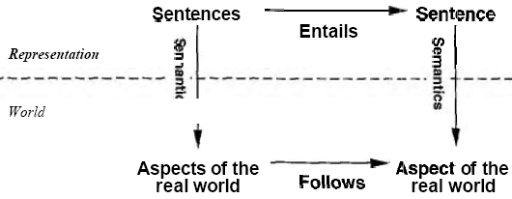
Property of Inference Algorithm
An inference algorithm that derives only entailed sentences is called sound or truth-preserving.
An inference algorithm is complete if it can derive any sentence that is entailed.
If KB is true in the real world, then any sentence Alpha derived from KB by a sound inference procedure is also true in the real world.
The grounding-the connection, between logical reasoning processes and the real environment.
Sensors and learning

Slide 27
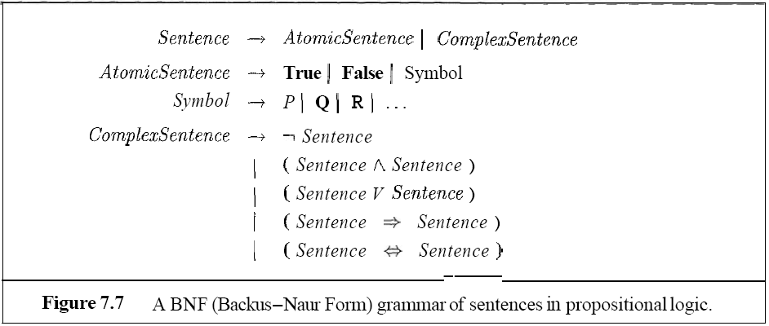
Propositional logic: Syntax
Propositional logic is the simplest logic
  If S is a sentence, ¬S is a sentence (negation /非)
  If S1 and S2 are sentences, S1  S2 is a sentence (conjunction / 合取)
  If S1 and S2 are sentences, S1  S2 is a sentence (disjunction / 析取)
  If S1 and S2 are sentences, S1  S2 is a sentence (implication / 蕴含)
  If S1 and S2 are sentences, S1  S2 is a sentence (biconditional )
The proposition symbols P1, P2 etc are sentences
from highest to lowest

Slide 28
Propositional logic: Semantics
Each model specifies true/false for each proposition symbol
  false true false
With these symbols, 8 possible models, can be enumerated automatically.
¬S is true iff S is false
S₁ ∧ S₂ is true iff S₁ is true and S₂ is true
S₁ ∨ S₂ is true iff S₁is true or S₂ is true
S₁ ⇒ S₂ is true iff S₁ is false or S₂ is true
S₁ ⇔ S₂ is true iff S₁⇒S₂ is true and S₂⇒S₁ is true
Simple recursive process evaluates an arbitrary sentence, e.g.,
¬P_{1,2} ∧ (P_{2,2} ∨ P_{3,1}) = true ∧ (true ∨ false) = true ∧ true = true
Rules for evaluating truth with respect to a model m:
E.g. P1,2 P2,2 P3,1

Slide 29
Wumpus world sentences
Let P_{i,j} be true if there is a pit in [i, j].
Let B_{i,j} be true if there is a breeze in [i, j].
¬ P_{1,1}
  ¬B_{1,1}
  B_{2,1}
"Pits cause breezes in adjacent squares“
  B_{1,1} ⇔ (P_{1,2} ∨ P_{2,1})
  B_{2,1} ⇔ (P_{1,1} ∨ P_{2,2} ∨ P_{3,1})

Slide 30

Truth tables for inference

Slide 31

Inference by enumeration
Depth-first enumeration of all models is sound and complete
For n symbols, time complexity is O(2^{n}), space complexity is O(n)

Slide 32

Logical equivalence
Two sentences are logically equivalent} iff true in same models: α ≡ ß iff α╞ β and β╞ α

Slide 33
Validity and satisfiability
A sentence is valid if it is true in all models,
  e.g., True, A ∨¬A, A ⇒ A, (A ∧ (A ⇒ B)) ⇒ B
Validity is connected to inference via the Deduction Theorem:
  KB ╞ α if and only if (KB ⇒ α) is valid
A sentence is satisfiable if it is true in some model
  e.g., A∨ B, C
A sentence is unsatisfiable if it is true in no models
  e.g., A∧¬A
Satisfiability is connected to inference via the following:
  KB ╞ α if and only if (KB ∧¬ α) is unsatisfiable
  α╞ β if and only if the sentence (α ∧ ¬β ) is unsatisfiable

Slide 34
Proof methods
Proof methods divide into (roughly) two kinds:
  Application of inference rules
    Legitimate (sound) generation of new sentences from old
  Model checking
    truth table enumeration (always exponential in n)
    e.g., min-conflicts-like hill-climbing algorithms
    improved backtracking, e.g., Davis--Putnam-Logemann-Loveland (DPLL)
    Heuristic search in model space (sound but incomplete)
    Proof = a sequence of inference rule applications_x000b_Can use inference rules as operators in a standard search algorithm
    Typically require transformation of sentences into a normal form

Slide 35



Inference Rules
Modus Ponens:
And-Elimination:
Other rule:

Slide 36
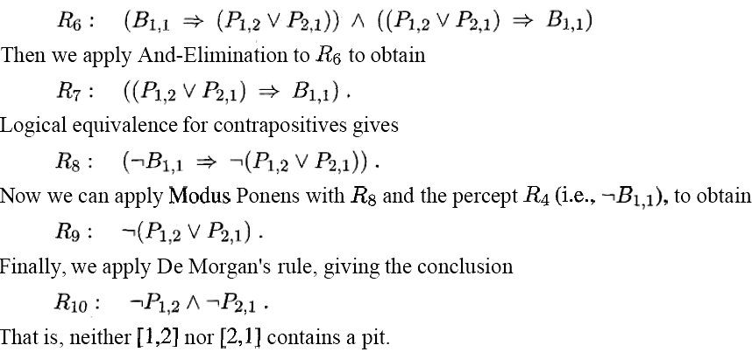
The preceding derivation a sequence of applications of inference rules is called a proof.
Finding proofs is exactly like finding solutions to search problems.
Searching for proofs is an alternative to enumerating models.

Slide 37
Resolution
Resolution inference rule (for CNF):
l₁ ∨… ∨ l_{k}, m₁ ∨ … ∨ m_{n}
where l_{i} and m_{j} are complementary literals.
E.g., P_{1,3} ∨ P_{2,2}, ¬P_{2,2}
Resolution is sound and complete
for propositional logic
P1,3
l1  …  li-1  li+1  …  lk  m1  …  mj-1  mj+1 ...  mn

Slide 38
Conversion to CNF
Conjunctive Normal Form (CNF)
  conjunction of disjunctions of literals: clauses
  E.g., (A ∨ ¬B) ∧ (B ∨ ¬C ∨ ¬D)
  B_{1,1} ⇔ (P_{1,2} ∨ P_{2,1})
Eliminate ⇔, replacing α ⇔ β with (α ⇒ β)∧(β ⇒ α).
  (B_{1,1} ⇒ (P_{1,2} ∨ P_{2,1})) ∧ ((P_{1,2} ∨ P_{2,1}) ⇒ B_{1,1})
2. Eliminate ⇒, replacing α ⇒ β with ¬α∨ β.
  (¬B_{1,1} ∨ P_{1,2} ∨ P_{2,1}) ∧ (¬(P_{1,2} ∨ P_{2,1}) ∨ B_{1,1})
3. Move ¬ inwards using de Morgan's rules and double-negation:
  (¬B_{1,1} ∨ P_{1,2} ∨ P_{2,1}) ∧ ((¬P_{1,2} ∧ ¬P_{2,1}) ∨ B_{1,1})
4. Apply distributivity law (∧ over ∨) and flatten:
  (¬B_{1,1} ∨ P_{1,2} ∨ P_{2,1}) ∧ (¬P_{1,2} ∨ B_{1,1}) ∧ (¬P_{2,1} ∨ B_{1,1})

Slide 39
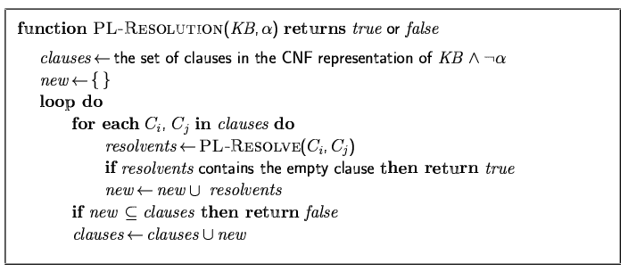
Resolution algorithm
Proof by contradiction, i.e., show KB∧¬α unsatisfiable

Slide 40

Resolution example
KB = (B_{1,1} ⇔ (P_{1,2}∨ P_{2,1})) ∧¬ B_{1,1}
α = ¬P_{1,2}

Slide 41
Forward and backward chaining
Horn Form (restricted)
  KB = conjunction of Horn clauses
Horn clause : a disjunction of literals of which at most one is positive
    E.g., ¬L_{1,1} ∧ ¬ Breeze ∧ B_{1,1}, L_{1,1} ∧ Breeze ⇒ B_{1,1}
    proposition symbol, (conjunction of symbols) ⇒ symbol
    E.g., C ∧ (B ⇒ A) ∧ (C ∧ D ⇒ B),
Modus Ponens (for Horn Form): complete for Horn KBs
α₁, … ,α_{n}, α₁ ∧ … ∧ α_{n} ⇒ β
β
Can be used with forward chaining or backward chaining.
These algorithms are very natural and run in linear time

Slide 42
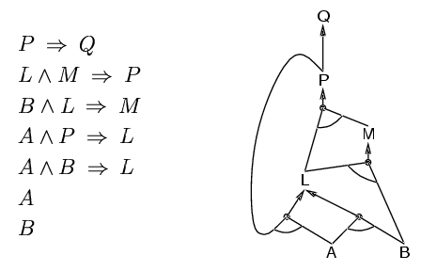
Forward chaining
Idea: find any rule whose premises are satisfied in the KB,
  add its conclusion to the KB, until query is found

Slide 43
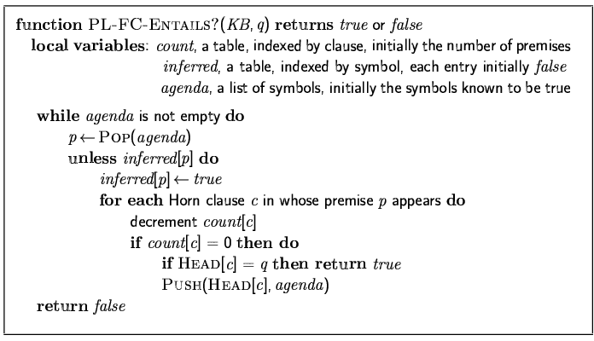
Forward chaining algorithm
Forward chaining is sound and complete for Horn KB

Slide 44
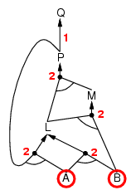
Forward chaining example
A
B

Slide 45
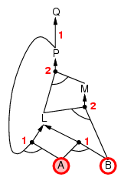
Forward chaining example
A ∧ ?P => ?L

Slide 46
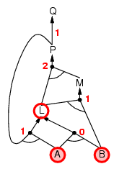
Forward chaining example
A ∧ B => L

Slide 47
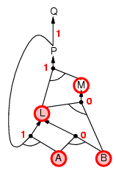
Forward chaining example
L ∧ B => M

Slide 48
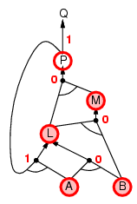
Forward chaining example
M ∧ L => P

Slide 49
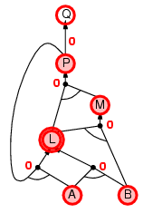
Forward chaining example
P => Q

Slide 50
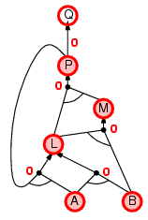
Forward chaining example
A ∧ P => L

Slide 51

Forward chaining example
P => Q

Slide 52
Proof of completeness
FC derives every atomic sentence that is entailed by KB
  FC reaches a fixed point where no new atomic sentences are derived
  Consider the final state as a model m, assigning true/false to symbols
  Every clause in the original KB is true in m
    a₁ ∧ … ∧ a_{k} ⇒ b
  Hence m is a model of KB
  If KB╞ q, q is true in every model of KB, including m

Slide 53
Backward chaining
Idea: work backwards from the query q:
  to prove q by BC,
    check if q is known already, or
    prove by BC all premises of some rule concluding q
Avoid loops: check if new sub-goal is already on the goal stack
Avoid repeated work: check if new sub-goal
  has already been proved true, or
  has already failed

Slide 54
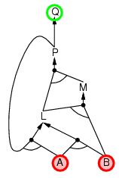
Backward chaining example
A
B
Q?

Slide 55
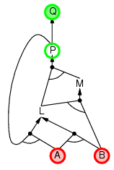
Backward chaining example
A
B
Q?<=P?

Slide 56
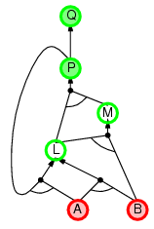
Backward chaining example
A
B
Q?<=P?
L? ∧ M? => P?

Slide 57
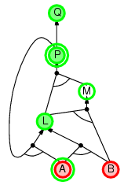
Backward chaining example
A
B
Q?<=P?
L? ∧ M? => P?
P? ∧ A => L?

Slide 58
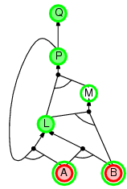
Backward chaining example
A
B
Q?<=P?
L? ∧ M? => P?
P? ∧ A => L?
A ∧ B => L

Slide 59
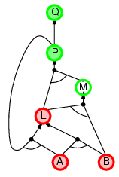
Backward chaining example
A
B
Q?<=P?
L? ∧ M? => P?
P? ∧ A => L?
A ∧ B => L

Slide 60
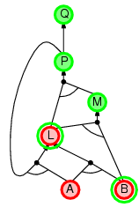
Backward chaining example
A
B
Q?<=P?
L? ∧ M? => P?
P? ∧ A => L?
A ∧ B => L
L ∧ B => M

Slide 61
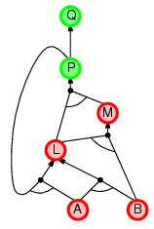
Backward chaining example
A
B
Q?<=P?
L ∧ M => P?
P? ∧ A => L?
A ∧ B => L
L ∧ B => M

Slide 62
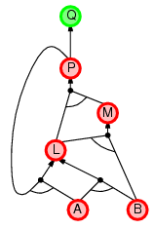
Backward chaining example
A
B
Q?<=P
L ∧ M => P
P? ∧ A => L?
A ∧ B => L
L ∧ B => M

Slide 63
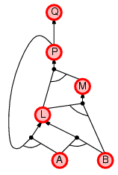
Backward chaining example
A
B
Q<=P
L ∧ M => P
P ∧ A => L
A ∧ B => L
L ∧ B => M

Slide 64
Forward vs. backward chaining
FC is data-driven, automatic, unconscious processing,
  e.g., object recognition, routine decisions
May do lots of work that is irrelevant to the goal
BC is goal-driven, appropriate for problem-solving,
  e.g., Where are my keys? How do I get into a PhD program?
Complexity of BC can be much less than linear in size of KB

Slide 65
Efficient propositional inference
Two families of efficient algorithms for propositional inference:
Complete backtracking search algorithms
DPLL algorithm (Davis, Putnam, Logemann, Loveland)
Incomplete local search algorithms
  WalkSAT algorithm

Slide 66
The DPLL algorithm
Determine if an input propositional logic sentence (in CNF) is satisfiable.
  Early termination
    A clause is true if any literal is true.
    A sentence is false if any clause is false.
  Pure symbol heuristic
    Pure symbol: always appears with the same "sign" in all clauses.
    e.g., In the three clauses (A ∨ ¬B), (¬B ∨ ¬C), (C ∨ A), A and B are pure, C is impure.
    Make a pure symbol literal true.
  Unit clause heuristic
    Unit clause: only one literal in the clause
    The only literal in a unit clause must be true.
Improvements over truth table enumeration:

Slide 67
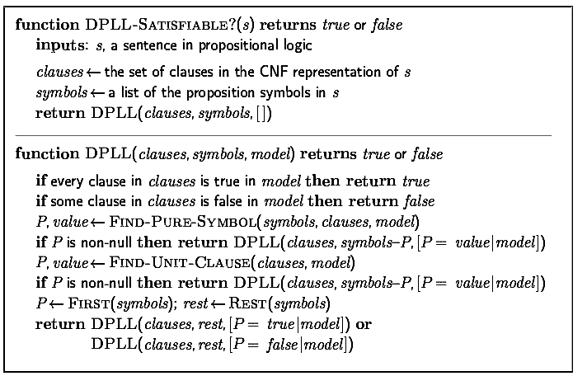
The DPLL algorithm

Slide 68
The WalkSAT algorithm
Incomplete, local search algorithm
Evaluation function: The min-conflict heuristic of minimizing the number of unsatisfied clauses
Balance between greediness and randomness

Slide 69
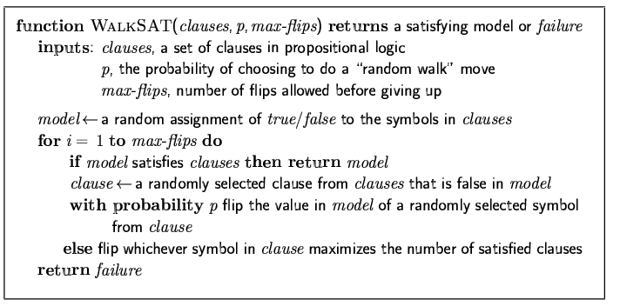
The WalkSAT algorithm

Slide 70
Hard satisfiability problems
Consider random 3-CNF sentences. e.g.,
(¬D ∨ ¬B ∨ C) ∧ (B ∨ ¬A ∨ ¬C) ∧ (¬C ∨ ¬B ∨ E) ∧ (E ∨ ¬D ∨ B) ∧ (B ∨ E ∨ ¬C)
  m = number of clauses
  n = number of symbols
  Hard problems seem to cluster near m/n = 4.3 (critical point)

Slide 71
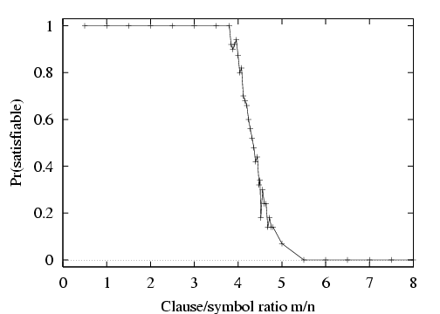
Hard satisfiability problems

Slide 72
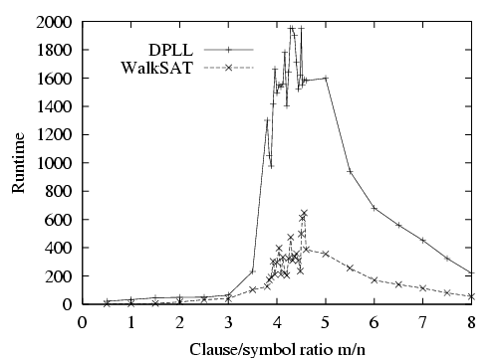
Hard satisfiability problems
Median runtime for 100 satisfiable random 3-CNF sentences, n = 50

Slide 73
Inference-based agents in the wumpus world
A wumpus-world agent using propositional logic:
  ¬P_{1,1}
  ¬W_{1,1}
  B_{x,y} ⇔ (P_{x,y+1} ∨ P_{x,y-1} ∨ P_{x+1,y} ∨ P_{x-1,y})
  S_{x,y} ⇔ (W_{x,y+1} ∨ W_{x,y-1} ∨ W_{x+1,y} ∨ W_{x-1,y})
  W_{1,1} ∨ W_{1,2} ∨ … ∨ W_{4,4}
  ¬W_{1,1} ∨ ¬W_{1,2}
  ¬W_{1,1} ∨ ¬W_{1,3}
  …
⇒ 64 distinct proposition symbols, 155 sentences

Slide 74
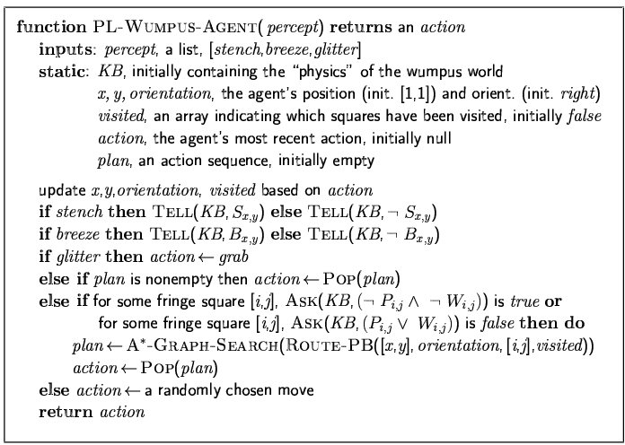

Slide 75
Expressiveness limitation of propositional logic
KB contains "physics" sentences for every single square
For every time t and every location [x ,y ],
L^{t}_{x,y} ∧ FacingRight ^{t} ∧ Forward ^{t} ⇒ L^{t+1}_{x+1,y}
Rapid proliferation of clauses
t
t

Slide 76
Summary
Logical agents apply inference to a knowledge base to derive new information and make decisions
Basic concepts of logic:
  syntax: formal structure of sentences
  semantics: truth of sentences wrt models
  entailment: necessary truth of one sentence given another
  inference: deriving sentences from other sentences
  soundness: derivations produce only entailed sentences
  completeness: derivations can produce all entailed sentences
Wumpus world requires the ability to represent partial and negated information, reason by cases, etc.
Resolution is complete for propositional logic
Forward, backward chaining are linear-time, complete for Horn clauses
Propositional logic lacks expressive power

